Slide 1


1
2
3
4
ENERGY CONSUMPTION ACROSS BORDERS
GitHub
Queries
Tables
Git
Learn Git’s role in version control, branching, and merging, and how we used it for efficient collaboration.
Present our database tables and their relationships. Highlight how we connected and extended pre-defined tables.
Describe GitHub’s role in our project and its use for teamwork.
Present SQL queries for data analysis. Explain their goals and highlight key results

Slide 2
1
2
3
4
GitHub
Git
Tables
Queries
Describe GitHub’s role in our project and its use for teamwork.
Learn Git’s role in version control, branching, and merging, and how we used it for efficient collaboration.
Present our database tables and their relationships. Highlight how we connected and extended pre-defined tables.
Present SQL queries for data analysis. Explain their goals and highlight key results

Slide 3
1
GitHub
Describe GitHub’s role in our project and its use for teamwork.

Slide 4
What is GitHub?
Web-based platform:
Version control
Collaboration
GitHub combines these two features to enhance teamwork and code management.

Slide 5
Why GitHub was essential
Efficient collaboration
Traceability
Transparency
These features are powered by Git, the version control system.

Slide 6
2
Git
Learn Git’s role in version control, branching, and merging, and how we used it for efficient collaboration.

Slide 7


What is Git?
Functions:
Tracks changes in files
Allows you to load previous versions
Supports branching and merging

Slide 8
How did we use Git?
Clone Repository
Creating Branches
Commit and Push changes
Pull Requests and Merge

Slide 9
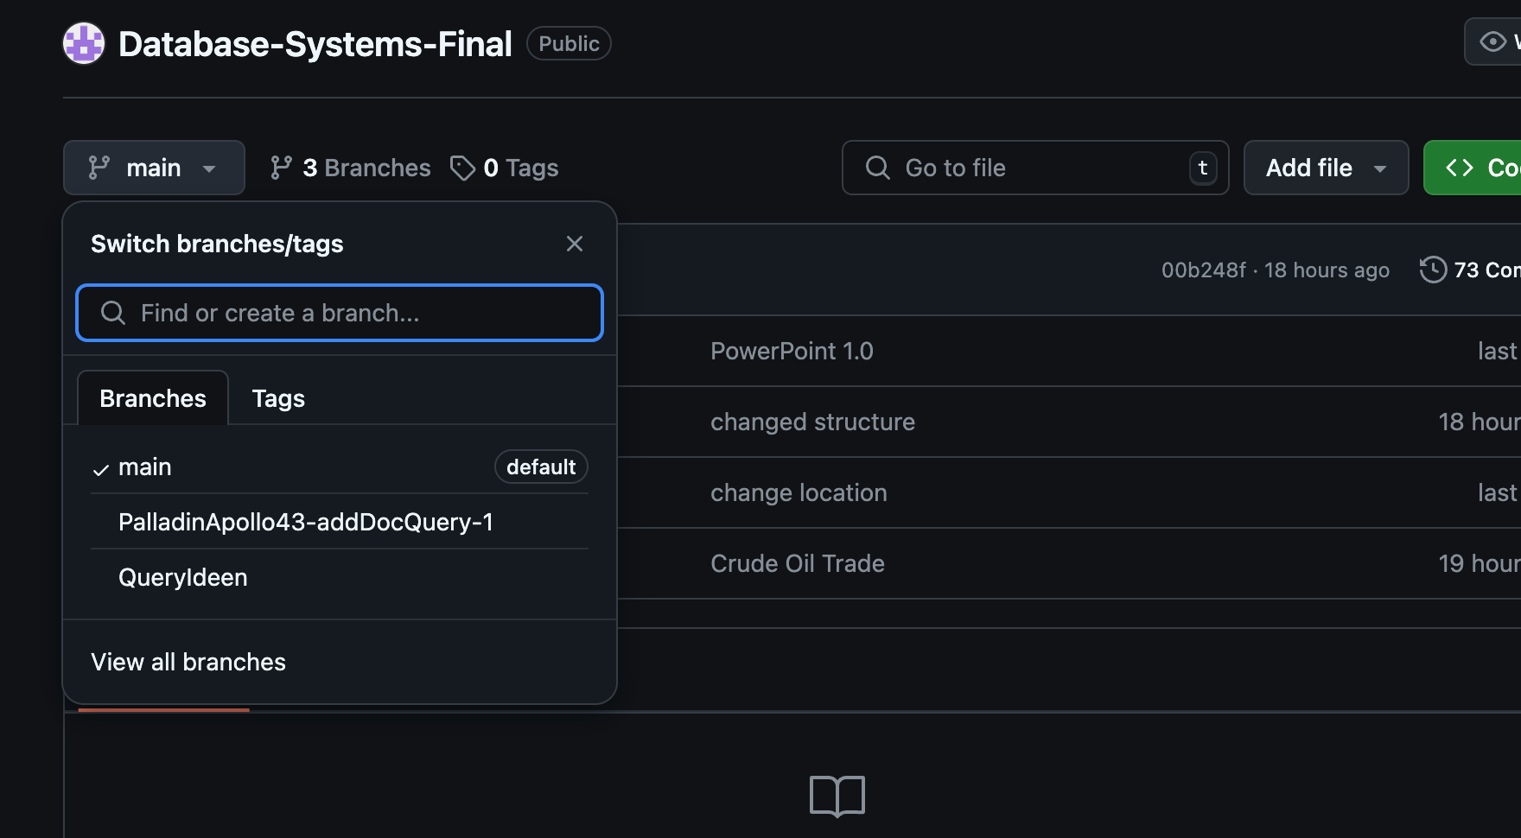
Example for Branches

Slide 10
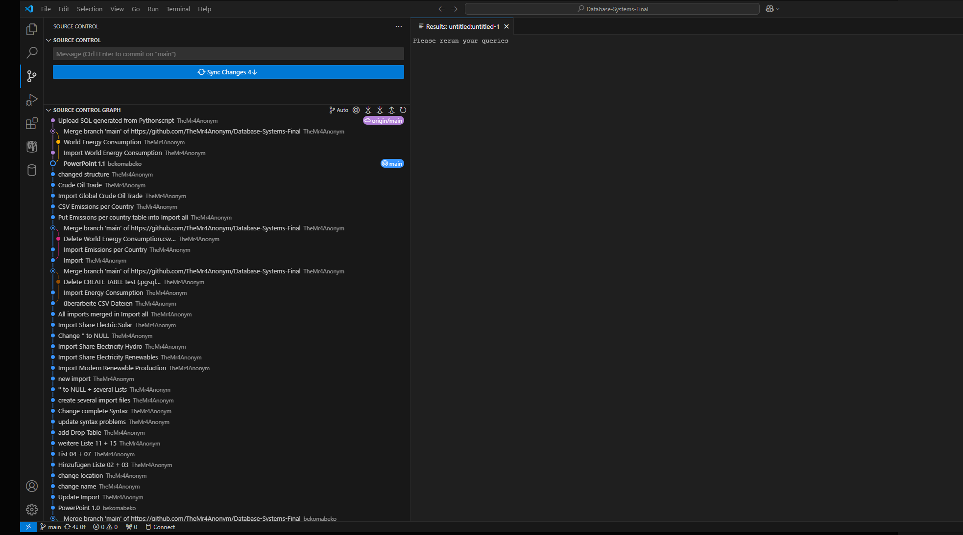
Example for Commits

Slide 11
3
Tables
Present our database tables and their relationships. Highlight how we connected and extended pre-defined tables.

Slide 12




HOW CAN WE IDENTIFY THE GLOBAL TRENDS IN RENEWABLE ENERGY?

Slide 13
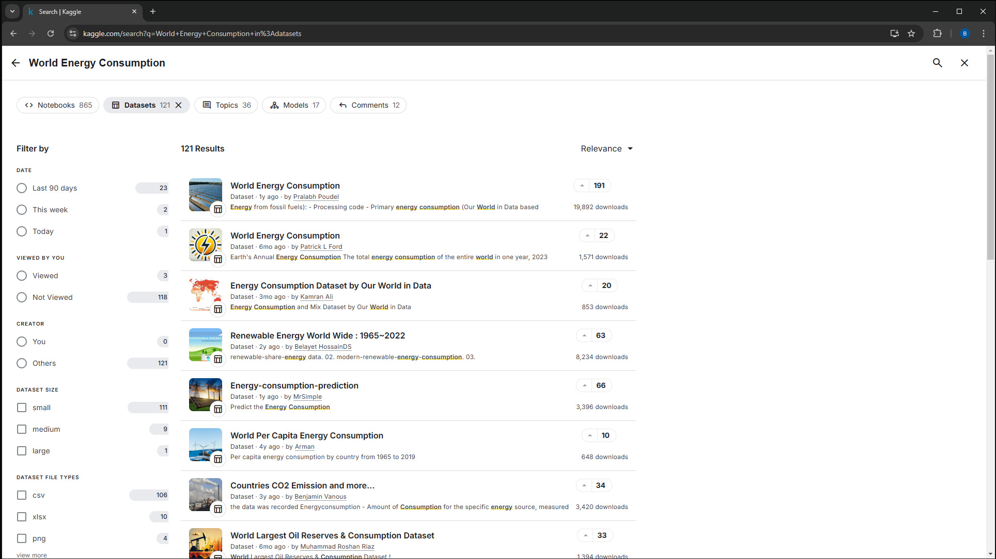
Where did we source our data?

Slide 14
Tables

Slide 15
Tables

Slide 16
Tables

Slide 17
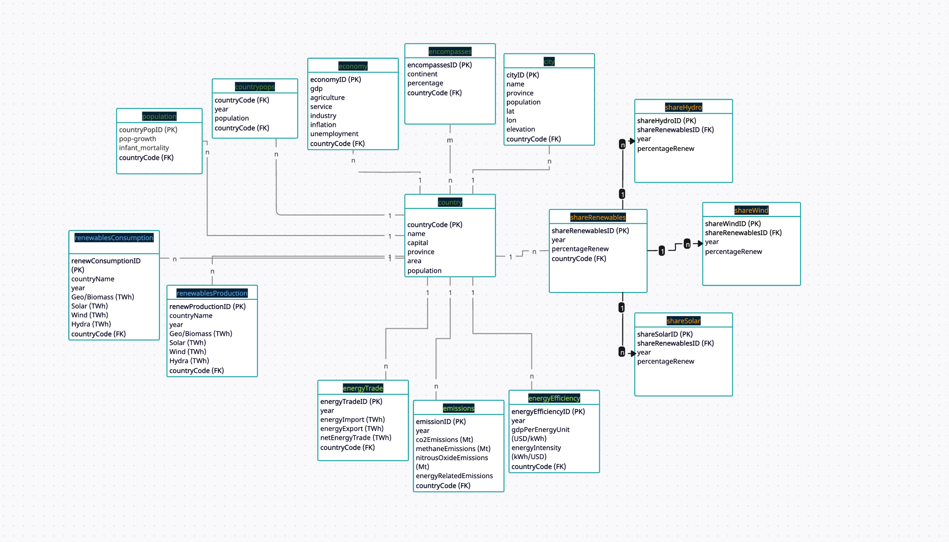

Slide 18
4
Queries
Present SQL queries for data analysis. Explain their goals and highlight key results

Slide 19

Queries

Slide 20

Thank You!

